Slide 1


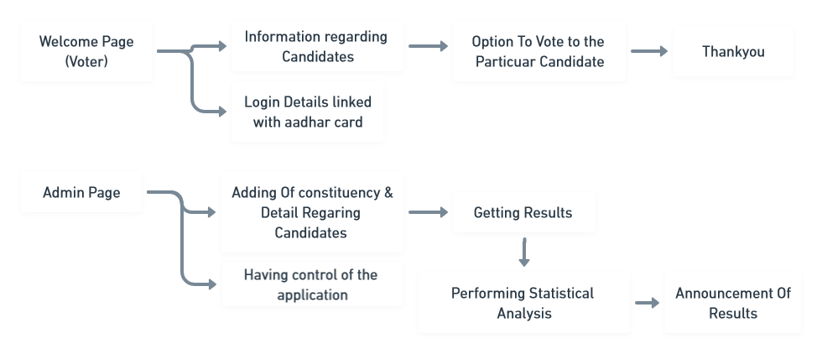
NITTE MEENAKSHI INSTITUTE OF TECHNOLOGY
(An Autonomous Institution)
DEPARTMENT OF COMPUTER SCIENCE AND ENGINEERING
E-VOTING SYSTEM USING BLOCKCHAIN & HOMOMORPHIC ENCRYPTION
TEAM MEMBERS:
1. Prateek G 3. Sheetal S Harshini
2. Shreya Hegde 4. V Venkata Sree Harsha
Under the guidance of:
Dr Ramesh Naidu , Asst. Professor
Dept. of CSE, NMIT, Bangalore
OBJECTIVES:
1. To achieve the Voting completely digital mode (i.e) Online Mode
2. To make the voting system easy & secure
3. To perform statistical analysis on the data in which results in a unique set of insights
4. To make use of cutting edge technologies like Blockchain, React JS, etc…
INTRODUCTION: To make the voting system completely digital mode which helps the people to vote their candidate from their place. This makes the people to make sure that 100% voting is done and helps government to take statistical analysis of the data.
RESULT: Once after the voter has successfully casted their vote, the admin will be able to see and perform analysis on the voting and declares the results according to the constituency. So this way the voting will be easy to people and also for the government
FUTURE SCOPE: Developing this application in a higher level where it can be released in a small area and taking the input from people that how convenient they are able to use the application, and developing the application according to the people’s input. And also improving the security of the application according to the latest security changes.
References:
[1] Paul Cuff - Sanjeev Kulkarni - Mark Wang - John Sturm, “Voting Research – VotingTheory
[2] Sarah Diamond, “Are You Voting “No” to Paper Ballots
[3] Sadia, Kazi, Md. Masuduzzaman, Rajib Kumar Paul and Anik Islam. “Blockchain-Based Secure E-Voting with the Assistance of Smart Contract

